Slide 1
NYC City Bike Rideshare Study and Forecasting
Xi Yan & Marissa Ferrighetto

Slide 2
Key Findings & Implications
Our trained models performed better than the baselines for the two research questions
The classification models can aid program administrators in deciding which bike types to distribute to a specific start station when they are facing a distribution problem
The models can also help them understanding ridership trends by the type of user engagement
Understanding these trends can allow them to create user personas to guide marketing decisions and user experience considerations as the program grows

Slide 3
Why research NYC bike data?
Other cities have ride shares; this analysis could be applied to other locales
Interest in analyzing urban trends as public policy and information systems students
Importance of using our data analysis skills for the public good

Slide 4
Domain & Learning
“A Computer Program is said to learn from experience with respect to some class of tasks T and performance measure P, if its performance at tasks in T, as measured by P, improves with E.”
T: classification modeling
E: training and model fitting
P: accuracy of the models
Goal: use the training of the classification models to learn and improve the performance
Achieve over 50% of accuracy or other relevant metrics when doing a binary classification
Over 100/n% when we are doing n numbers classification

Slide 5
Related Readings
1.Citi Bike Struggles to Keep Up With New Yorkers’ Love of Cycling
Cycling growth during COVID
Program struggling to meet demand
2.Survey Says: City Voters Support Public Money Invested in Bike Share
Details the significance and public support for increasing subsidies and public funding for the New York City rideshare
3.New York 25x25 Plan
Plan asks mayoral candidate to commit to dedicating 25% of street space for people by 2025

Slide 6
What is the problem?
Increased demand for city bikes since the beginning of the COVID-19 pandemic lead to
Distribution problem: There are excess amount of bikes concentrated in some end stations where people generally find no bikes available in many stations. Redistribution is needed to address the supply and demand.
Business problem: How to direct increased funding as the bike program continues? Who uses the bike share problem? How can the program build user personas to segment and target users

Slide 7
Our Research Questions
1. How should the citibike act to respond to the first news, where there are distribution problems for bike share, to correctly redistribute the correct types of bikes back to the station needed?
2. To meet the increasing demand for bike share and the New York 25x25 policy plan, how should citibike market to accurately identify locate, and attract potential users?

Slide 8

Our Data Set
NYC City Bike data from February of 2021 to March 2022
Columns:
Ride ID
Rideable type
Started at
Ended at
Start station name
Start station ID
End station name
End station ID
Start latitude
Start longitude
End latitude
End Longitude
Member or casual ride

Slide 9
Overall Approach
Classification problems
Split test and train data
Preprocessing (including addressing outliers, dropping null values, etc.), class imbalance mitigation, pipeline
Run multiple model types (random forest, k nearest neighbors, and logistic regressions) and compare the results

Slide 10
Research Question 1
How should the citibike act to respond to distribution problem and to correctly redistribute the most needed types of bikes back to the station which lack bikes?

Slide 11
Q1 Data Pipeline
Addressed class imbalance with random undersampling
Used MICE imputer for missing distance values
Used Standard scaler to scale numeric value
OneHotEncoded categorical features

Slide 12
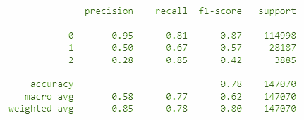
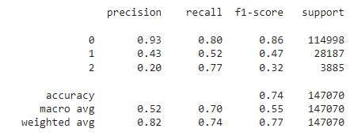
Q1 Random Forest & K Nearest Neighbors
Random forest (green) out performed KNN.

Slide 13
Question 1 Results
How to add value to Citibike: This model has given the Citibike, with high accuracy, to classify which types of bikes (classic, docked, and ebike) should be redistributed to which start location of the city.
If a truck driver for Citibike is driving a truck with loaded different types of bikes, your chances of dropping those bikes to the correct location is expected to be 100% more correct than randomly guessing.

Slide 14
Research Question 2
To meet the increasing demand for bike share and the New York 25x25 policy plan, how should citibike market to accurately identify, locate, and attract potential users to subscribe to the program?

Slide 15
Q2 Data Pipeline
Sampled the training set for model performance
Addressed class imbalance with random undersampling
Used MICE imputer for missing distance values
Used Standard scaler to scale numeric value
OneHotEncoded categorical features

Slide 16
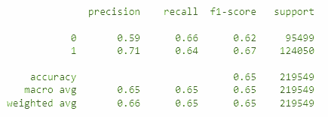
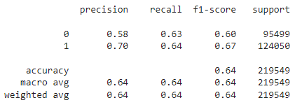
Q2- Random Forest & Logistic Regression
Random forest (green) narrowly out performed Logistic regression
This is 30% improvement than the baseline

Slide 17
Question 2 Results
How to add value to Citibike: The model performance was 30% higher than random guessing. This data-driven and validated approach can inform marketing and user experience improvements.
Result uses: predict the type of users (subscriber vs. non-subscriber) that are using the bikeshare.

Slide 18
Conclusions
As sustainability and alternate modes of transportation increase in importance, the scalability and investment decisions of bikeshare programs in large metropolitan areas such as NYC are incredibly important
Data science, specifically machine learning, is a great tool to drive decision making and understand users in very large data sets
Our models could be expanded upon and utilized to improve the redistribution process, guide investment decisions of which types of bikes to purchase in the coming years, and understanding user groups to target with advertising campaigns

Slide 19
Future work
Given more time, we can train models with GridSearchCV by tuning more parameters to improve the performance.
Given more resources, such as computational power, we can upsample the class imbalance instead of downsampling and we can skip the sampling process to reduce size in part 3.
We can also use other resample techniques instead of using pure random resample methods to improve performance.
We can continuously to test and train using the newest data from Citibike (publishes monthly) to update our models.

